Slide 1
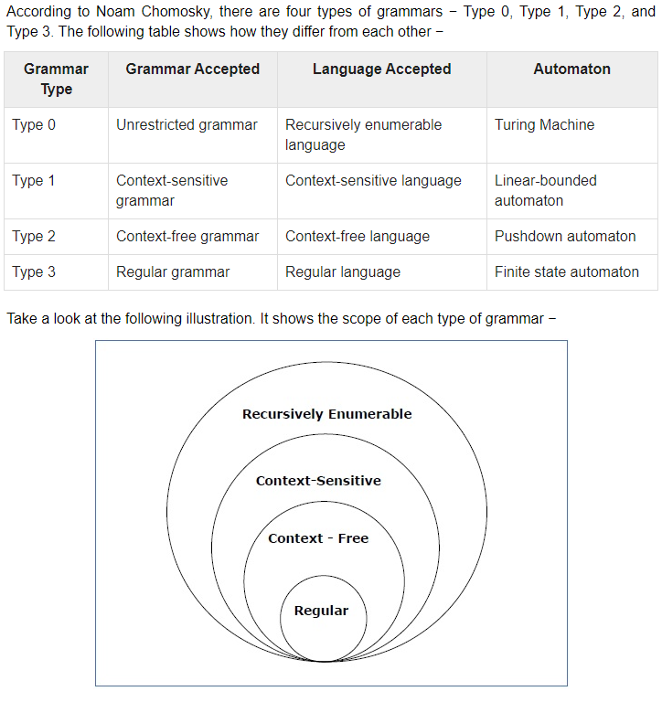
Week 3 – Chomsky’s Hierarchy of Grammars
Notes:
Source: Tutotialpoint [https://www.tutorialspoint.com/automata_theory/chomsky_classification_of_grammars.htm]

